Slide 1
Gamma knife for Paediatric patients less than 12 years- The AIIMS experience
Dr Deepak Agrawal
Additional Prof, Neurosurgery & GK
AIIMS, New Delhi

Slide 2
Introduction
Radiation therapy may have deleterious effects on the developing brain.
Stereotactic radiosurgery provides a high level of protection to normal brain and can be given in children as small as 4 years

Slide 3
Aims & Objectives
To review our experience of Gamma Knife radiosurgery in children less than 12 years of age

Slide 4
Materials & Methods
Retrospective chart review over 4 years (Jan 2011- September 2015)
Children (≤12 years) who underwent gamma knife radiosurgery
Demographic data, diagnosis and whether gamma knife was done in local or general anaesthesia.

Slide 5
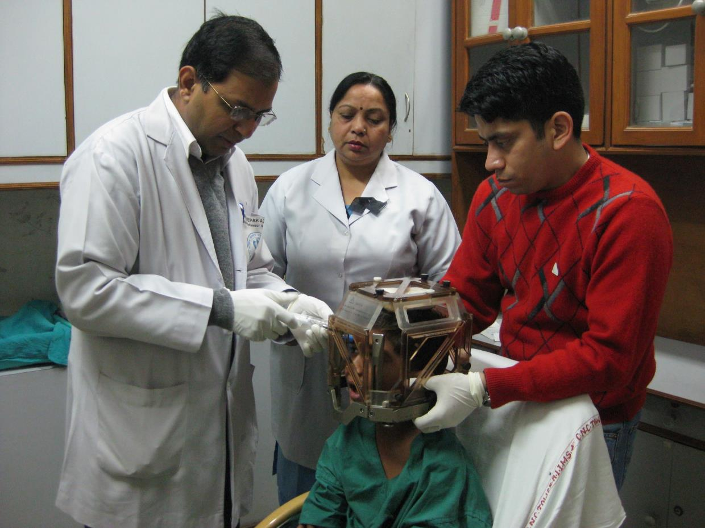

Slide 6
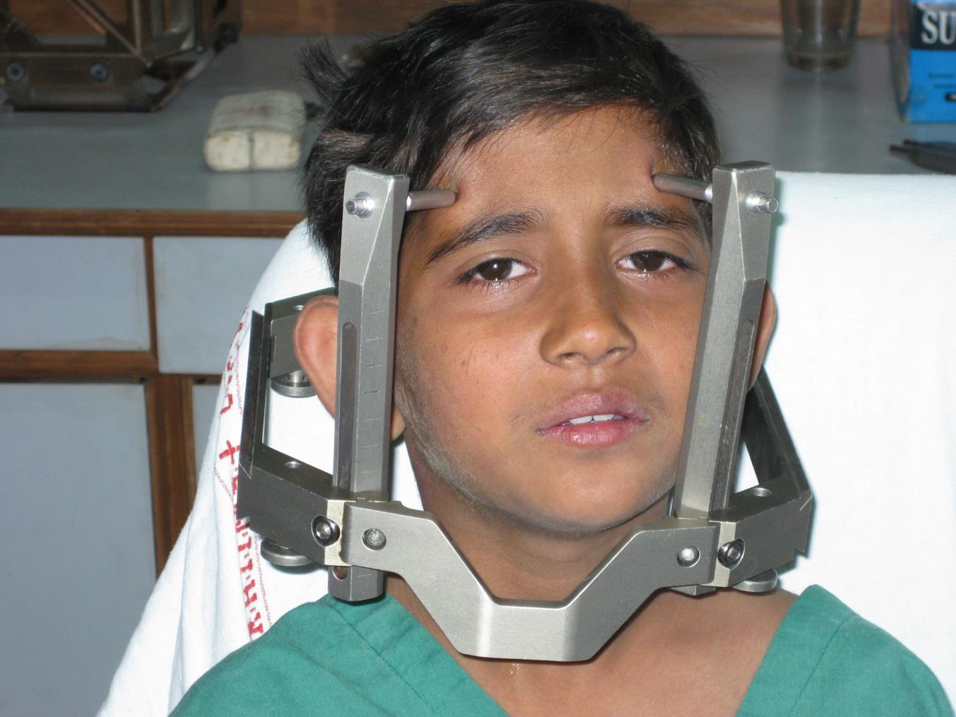

Slide 7
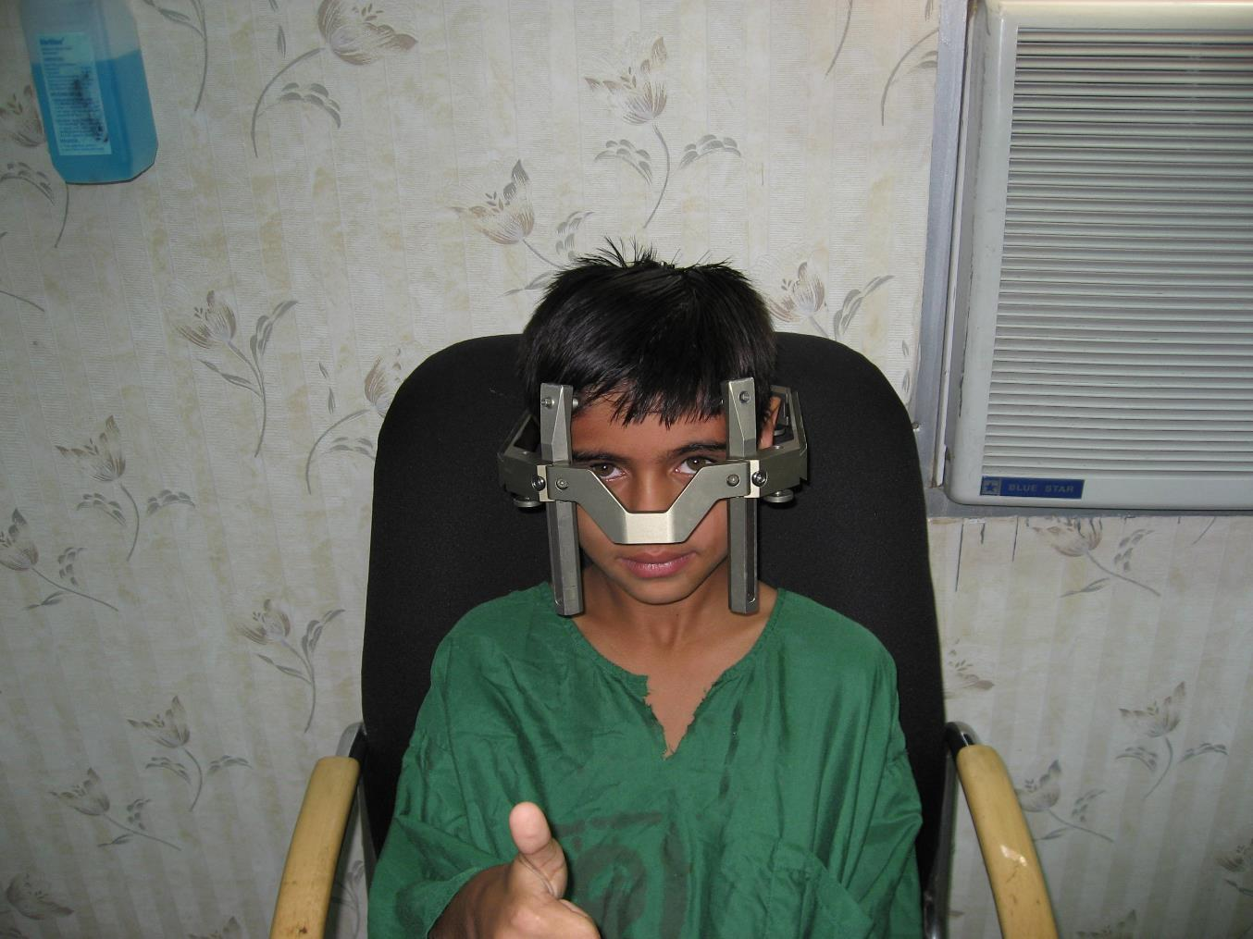

Slide 8
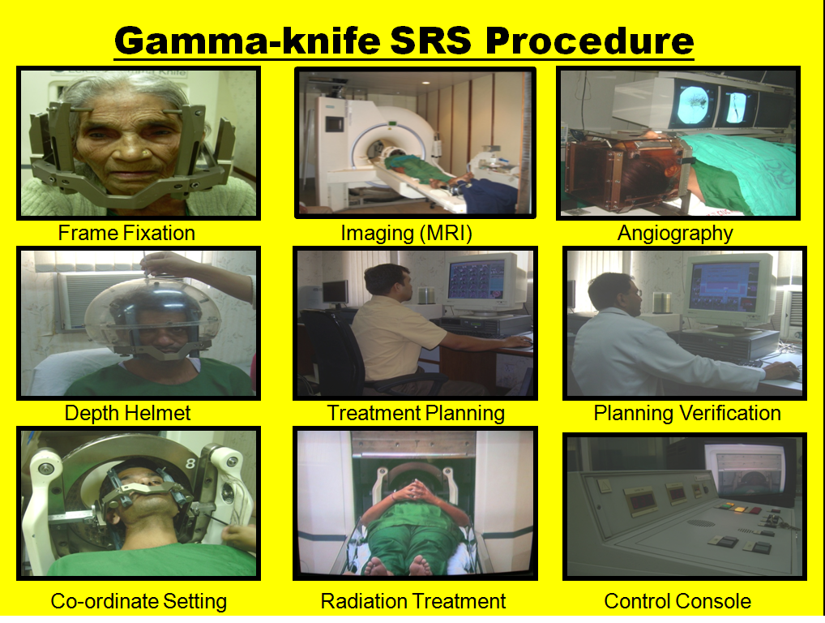

Slide 9
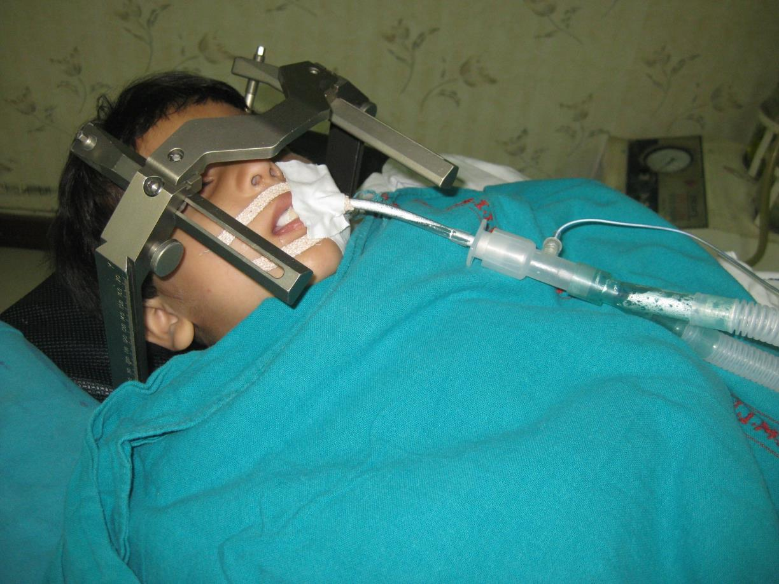

Slide 10
Results
A total of 41 children underwent gamma knife radiosurgery in the study period.
The mean age was 9.5 (range 4-11) with the male: female ratio of 2.4:1.

Slide 11
RESULTS
The most common indication was AVM (n= 26) followed by tumours (n=15)..

Slide 12
RESULTS
All children except two were done under local anaesthesia

Slide 13
CONCLUSIONS
Gamma Knife radiosurgery offers a compelling alternative to standard radiation therapy in children and may be especially useful in vascular malformations like AVM’s which are not amenable to surgery or embolization.
In addition as our experience shows that more than 95% of children can be given Gamma Knife under local anaesthesia

Slide 14
Thank You
drdeepak@gmail.com

